Slide 1
6CS003 – Graphics and Artificial Intelligence
Week 1
Module Overview

Slide 2
6CS003 Staff
Module Leader:
Dr Sarah Slater
Other Teaching Staff:
Dr Desmond Case

Slide 3
6CS003 Weekly Study Time
3 hours in class
7 hours self study
1 hr surgery time
Weeks 1 to 6 on Graphics
Weeks 7 to 12 on Artificial Intelligence

Slide 4
INTRODUCTION TO GRAPHICS

Slide 5


Graphics Drive Technology
Steve Jobs created Pixar and was behind Toy Story.
Computer graphics have driven Computer game development and growth
Good sources of reading:
www.cgw.com http://www.siggraph.org/

Slide 6
Introduction to Graphics
Library has many Graphics books. Although leading edge Computer Graphics techniques are constantly evolving, the fundamentals underpinning the subject are still relevant.
Each week you are advised to read about topics covered in class
Find your niche
3DS Max, HTML 5,
3DS Max, DirectX
Java 3D
VRML
3S Max, Unity
Doesn’t really matter what tools if you understand the underlying principles.

Slide 7
A Perspective
Lets have a look at how a typical 3d image/model is built up of triangles (simplest polygon)

Slide 8
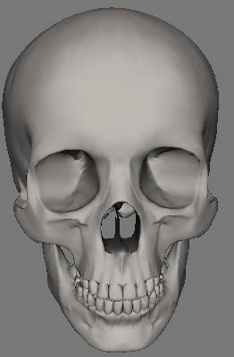
Step 1 the Artist
Lets consider this computer model of a skull….
It may have been developed in a package such as 3DS Max.
The artist may have used a graphics tablet and simply drew on screen, so their skills are probably more visual i.e an artist.

Slide 9
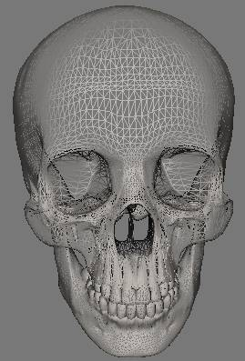
Step 2 the Science
But the artists was using a computer package and underpinning the graphics is computer science/maths because…
the image is actually a series of smaller shapes - triangle polygons in this case.

Slide 10


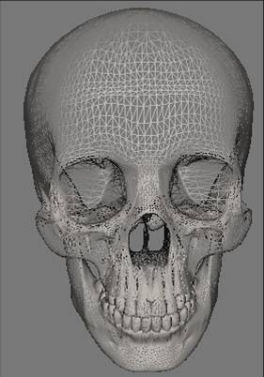
Step 3 Breaking it down
The skull is actually a mesh i.e. multiple polygons (triangles) joined together
The mesh has a texture applied to it.
Sculloc.x mesh from Direct X 9.0 SDK

Slide 11
3D Representation
The greater the number of polygons, the more accurately the object may be represented (particularly if any surfaces are curved, or small details are needed)
a polygon mesh model consists of a structure of vertices, each vertex being a 3 dimensional point having x, y, and z co-ordinates

Slide 12
3D Representation 2
Vertex
Joined By Edges
Can be a point in 3 dimensional space

Slide 13
Triangle Strip’s
Second Point(Vertex) x,y,z
We call each point in our triangle a vertex
First Point(Vertex) x,y,z
Third Point(Vertex) x,y,z

Slide 14
Triangle Strip 2
2nd Point(Vertex) x,y,z
4th Point(Vertex) x,y,z
squarevertex[4]
{
320, 240, 0,
320, 140, 0
420, 240, 0,
420, 140, 0,
}
1st Point(Vertex) x,y,z
3rd Point(Vertex) x,y,z
4 points needed
in some API’s we need to specify the coordinates in clockwise order, or at least say what the order is.

Slide 15
Triangle List
5th Point(Vertex) x,y,z
squarevertex[4]
{
320, 240,0,
320, 140,0,
420, 240,0,
320, 140,0
420, 140,0,
420, 240,0
}
4thPoint(Vertex) x,y,z
2nd Point(Vertex) x,y,z
6th Point(Vertex) x,y,z
1st Point(Vertex) x,y,z
3rd Point(Vertex) x,y,z
6 points needed

Slide 16
Co-ordinates of 2D object
Y
The four corners of the square could have (x,y) co-ordinates
(1,2)
(?,?)
2
How do we go from a square to a cube?
1
(?,?)
X
(1,1)
1
2

Slide 17
Making a Cube
To create a cube we must utilise the Z aspect of coordinates, with that
we mean the depth.
The back is at Z (1) and the front is Z (-1) or plane –1 and 1.
We will need define 6 squares in total.
A total of 12 triangles will be needed.
The left, right, top and bottom are a little tricky as some of the edges are connected to the front i.e. plane –1 and the other are connected to the back i.e. plane 1
Plane 1
Plane -1

Slide 18
Co-ordinates of 3D object
Here the eight corners of the cube would have (x,y,z) co-ordinates
Y
What could the co-ordinates be?
2
Z
1
X
1
2

Slide 19


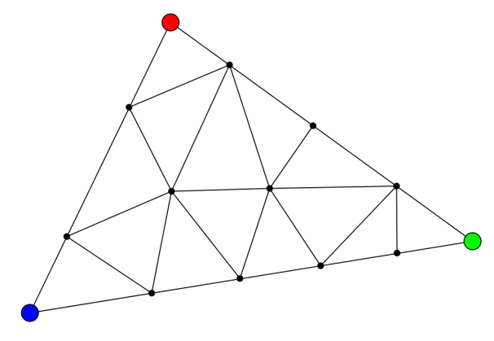
So…
So this image is really lots of.
http://www.crytek.com/games/ryse/overview

Slide 20
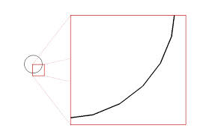
Smooth Edges and Antialiasing
A circle only appears smooth on the screen due to the number of points being plotted, if you zoom in enough it just is lines.
So resolution and quantity make a difference unless anti-aliasing is used.

Slide 21
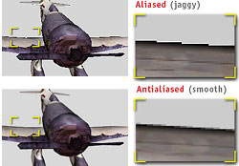
Anti-Aliasing
Helps to hide jagged edges(Jaggies)
http://www.nvidia.com/view.asp?IO=feature_accuview
Notes:
Specular Lighting – Gives metallic objects their sheen

Slide 22
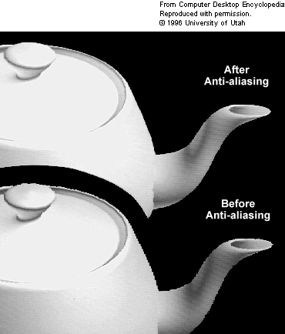
Anti-Aliasing
You can read more here
http://www.geforce.com/whats-new/guides/aa-af-guide#2
And here
http://www.tomshardware.com/reviews/anti-aliasing-nvidia-geforce-amd-radeon,2868.html

Slide 23
Self Study
Look at the material found at the web addresses in these slides
Have a look at a few videos of how 3D modellers develop everyday objects such as house…
  http://www.youtube.com/watch?v=-Wlupz2EKXQ

Slide 24
ASSIGNMENT 1: GRAPHICS
TASK 1 – CIRCLE DRAWING

Slide 25
Assessment for Graphics
You will be assessed by your ability to implement five of the standard algorithms used in computer graphics.
This tests your practical understanding of some fundamental graphics algorithms.
Each exercise will form part of a portfolio of work which you will submit in teaching week 6.

Slide 26
In the Workshop
Download from Wolf and save: -
  Task 1.zip
  It contains a HTML file, CSS file and 2 java script files.
  Run the application by running index.html
  Each week you will need to modify the jsToBeUpdated.js file found in the relevant task.
  Once you are happy with your code you need to validate it in JSLint (www.jslint.com). This checks your Java Script for conformance.

Slide 27
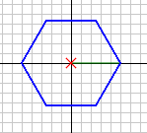
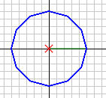
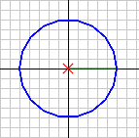
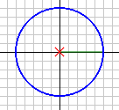
Task 1 – Drawing a Circle
Since it is impossible to draw a perfect circle on the screen, in practice a circle is normally approximated by a set of short straight lines (the more lines the better the circle).
6 Lines 12 Lines 18 Lines 60 Lines

Slide 28
Task 1 – Drawing a Circle
Your task is to add code to the method “drawCircle”.
Take as input the centre of the circle (x,y), the radius of the circle, and the number of straight lines to be drawn to create a circle.
Your code should then draw the circle the correct size in the correct position.
The window for your drawing is size 800 by 600 with the origin in the centre. (400 to 300) (mapped to 0,0

Slide 29
Draw a Circle
The co-ordinates of any point on the edge of a circle centred at the origin may be obtained from the following equations: -
X = Radius*cosine(∅)
Y = Radius*sine(∅)
where ∅ is the angle in radians between the X axis and a point on the circle (in an anti-clockwise direction)

Slide 30
Draw a Circle
=degrees*π/180
X = Radius*cosine(∅)
Y = Radius*sine(∅)
Y-axis
Radius
∅
X-axis

Slide 31
Hints
Don’t forget to convert degrees to radians
Hint: Radian = Angle * (pi/180)
Think about what happens if the total degrees in a circle are not divisible by the number of steps i.e.
360/70 = 5.14

Slide 32
Bresenham’s Circle
When you have finished that exercise, have a look at an alternative algorithm:
http://delivery.acm.org/10.1145/360000/359432/p100-bresenham.pdf?ip=134.220.86.35&acc=ACTIVE%20SERVICE&CFID=63305064&CFTOKEN=95785494&__acm__=1327330143_1fd8a80a28a83f6b624e1d6d50e5e548

